Slide 1
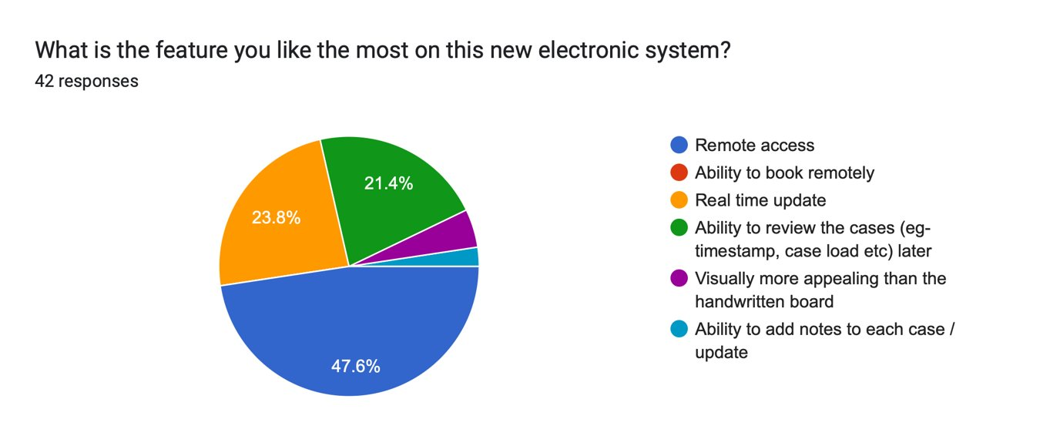
Using Microsoft Teams to improve patient experience, communication, safety and efficiency in the CEPOD theatre. N. Baxter-Evans, N. Qureshi, L. Connolly, S. Hare
Introduction: The delivery plan for the elective recovery programme after the COVID19 pandemic was published in 2022. This multifaceted plan relies heavily on staff and infrastructure which are already under significant pressure from a growing, aging emergency surgical population. To ensure maximal delivery of the elective recovery plan, emergency operating theatres therefore must be as efficient and ambulatory as possible. Many factors such as hospital bed capacity, financial constraints and the significant work force crisis are beyond the sphere of influence of the perioperative team but small iterative local efficiency improvements can have wide impact. Therefore, using MS Teams (a powerful software tool which has been made popular but is often under-utilized) we designed a high-impact, cost-neutral, multidisciplinary communication tool to improve the efficiency and effectiveness of the CEPOD operating theatres.
Method:
Using MS TEAMS we created a live CEPOD channel specifically for booking cases. Patients can be booked remotely by accessing Teams from any location. Data fields iteratively evolved to meet clinical need. Checks + hard-stops are in place to ensure inter-specialty communication. An SOP and training was provided to all staff. This aligns with the Royal College of Anesthetists recommendations for using electronic booking systems for emergency cases (RCoA, 2023).
Results: Impact analysis
Patient experience:
Improved certainty in time of their operation to allow planning
Increased ambulatory management
Reduction in unnecessary fasting times
Reduction in cancellation near to the point of surgery due to incomplete preoperative work-up
Theatre efficiency + hospital flow:
Improved hospital flow + reduced bed days for emergency surgery
Improved compliance to NCEPOD timeliness to theatre
Easy analysis of CEPOD efficiency
Reduction in “patient not ready” events
Easy prediction of high CEPOD demand allowing early planning for second theatre and validation of this to executives.
Improving staff experience:
Accessibility of live CEPOD board remotely + preoperative assessment details/live fasting time
Instant access to preoperative risk score (NELA guidance)
Clinical Governance:
Use of data to support SI investigations
Above: View of live board
Conclusion:
This has been one of the single most successful high impact interventions in improving theatre efficiency at our institution, with consistent buy-in from staff. Iterative improvement to the system makes it powerful, cost-neutral tool with wide-reaching use for patient safety, communication & efficiency.
Above: Survey of Surgeons and Anaesthetists feedback from live board
Next Steps:
Develop TEAMS virtual briefings to improve turn around times.
Incorporate the entire booking process on the live board.
References: Bahlmann, B., Kakodkar, P. & Morris, C., 2023. Royal College of Anesthetists. Chapter 5 Guidelines for the Provision of Anesthesia Services (GPAS), 07th February, p. p6 1.18.

